Slide 1
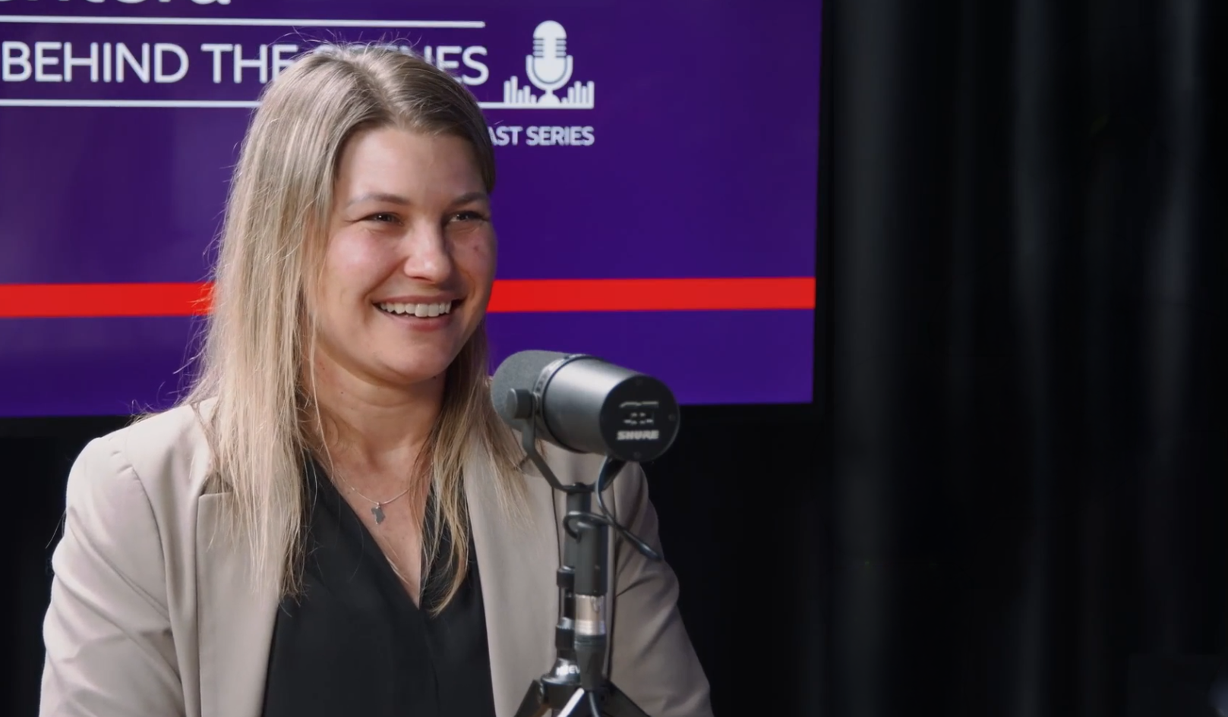

S2 EPISODE 10
JARETHA LOMBAARD
SENIOR ENGINEER

